Slide 1
SQL
SQL Languages
DQL
DML
DDL
DCL
DTL
D what the … L

Slide 2
INTRODUCTION - SQL - Structured Query Language
SQL is used for CRUD:
Creating databases
Adding, modifying and deleting database structures
Inserting, deleting, and modifying records in databases
Querying databases (data retrieval)
Create/Update Database Users
SQL functions as a standard relational database language
It can be used (with minor dialectical variations) with the majority of relational DBMS software tools

Slide 3
INTRODUCTION – SQL Command Categories
Data Definition Language (DDL)
Used to create Database Objects.
Data Manipulation Language (DML) - Used to update data in a db.
insert, update, delete, merge
Data Control Language (DCL): used to control access to data stored in a database (Authorization). Examples of DCL commands include:
GRANT , REVOKE
Transaction Control Language (TCL)
These are used to manage the changes made by DML statements as Trasnactions.
It also allows statements to be grouped together into logical transactions.
commit; rollback to savepoint-name; savepoint savepoint-name;
Data Query Language (DQL)
SELECT

Slide 4
INTRODUCTION – SQL Command Categories
Data Control Language (DCL):
used to control access to data stored in a database (Authorization). Examples of DCL commands include:
GRANT to allow specified users to perform specified tasks.
REVOKE to cancel previously granted or denied permissions.
Examples:
grant create table to username;
alter user username quota unlimited on system;
grant create any table to username;
grant drop any table to username;

Slide 5
INTRODUCTION – SQL Command Categories
Transaction Control Language (TCL)
used to manage transactions in a db
These are used to manage the changes made by DML statements.
It also allows statements to be grouped together into logical transactions.
commit;
rollback to savepoint-name;
savepoint savepoint-name;

Slide 6
INTRODUCTION - DDL
Data Definition Language (DDL)
Used to create and modify the structure of the database
Example commands:
CREATE
ALTER
DROP
The schema for each relation.
The domain of values associated with each attribute.
Integrity constraints
And also other information such as
The set of indices to be maintained for each relations.
Security and authorization information for each relation.
The physical storage structure of each relation on disk.

Slide 7
INTRODUCTION - DML
Data Manipulation Language (DML)
Used to insert, modify, delete and retrieve data
Example commands:
INSERT INTO
UPDATE
DELETE
SELECT

Slide 8
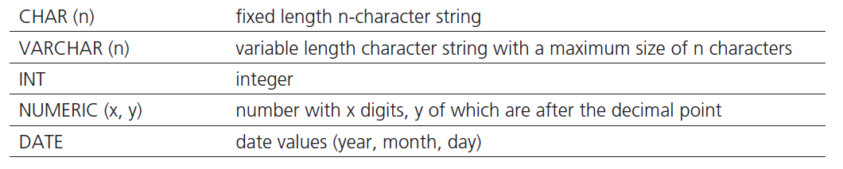
INTRODUCTION
SQL data types
Each column of each SQL created relation has a specified data type
Commonly used SQL data types:

Slide 9
INTRODUCTION - SQL
Brief SQL syntax notes
Semicolon “;” following the end of an SQL statement, indicates the end of the SQL command
SQL keywords, as well as the table and column names used in the SQL commands, are not case sensitive
E.g. SELECT is the same as select or SeLeCt
An SQL statement can be written as one long sentence in one line of text
However, for legibility reasons SQL statements are usually broken down into multiple lines of text

Slide 10
DDL
All DDL commands are auto-committed. That means it saves all the changes permanently in the database.
Command | Description
create | to create new table or database
alter | for alteration
truncate | delete data from table
drop | to drop a table
rename | to rename a table

Slide 11
CREATE TABLE
CREATE TABLE
Used for creating and connecting relational tables
Example:
create table instructor ( ID char(5), name varchar(20) not null, dept_name varchar(20), salary numeric(8,2))
insert into instructor values (‘10211’, ’Smith’, ’Biology’, 66000);
insert into instructor values (‘10211’, null, ’Biology’, 66000);

Slide 12
create table course ( course_id varchar(8) primary key, title varchar(50), dept_name varchar(20), credits numeric(2,0), foreign key (dept_name) references department) );
Primary key declaration can be combined with attribute declaration as shown above

Slide 13
ALTER TABLE
ALTER TABLE
Used to change the structure of the relation, once the relation is already created
Alter Statement 1: ALTER TABLE vendor ADD ( vendorphonenumber CHAR(11));
Alter Statement 2: ALTER TABLE vendor DROP ( vendorphonenumber);

Slide 14
DDL - DROP TABLE
DROP TABLE
Used to remove a table from the database
DROP TABLE Students;
TRUNCATE TABLE
truncate table Student;
Removes all tuples in Student table and reinitialize the table.
Different than DELETE command as delete just removes the tuples.
Truncate does note delete he scheme of the table.

Slide 15
Integrity Constraints in Create Table
not null
primary key (A₁, ..., A_{n} )
foreign key (A_{m}, ..., A_{n} ) references r
Example: Declare dept_name as the primary key for department
.
create table instructor ( ID char(5), name varchar(20) not null, dept_name varchar(20), salary numeric(8,2), primary key (ID), foreign key (dept_name) references department)

Slide 16
Integrity Constraints in Create Table
create table student ( ID varchar(5), name varchar(20) not null, dept_name varchar(20), tot_cred numeric(3,0), primary key (ID), foreign key (dept_name) references department) );
create table department ( ID varchar(5), dept_name varchar(20), building varchar(8), budget numeric(4,2), primary key (ID), );

Slide 17
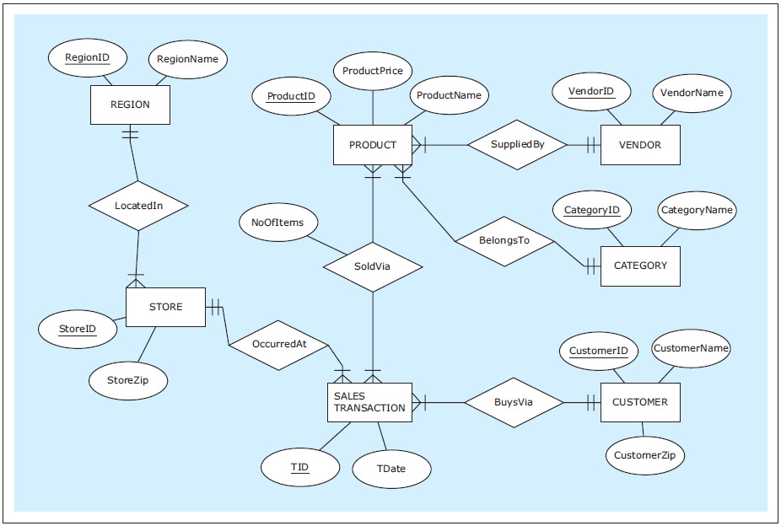
ER diagram : ZAGI Retail Company Sales Department Database
Notes:
This example is discussed on Page 70.

Slide 18
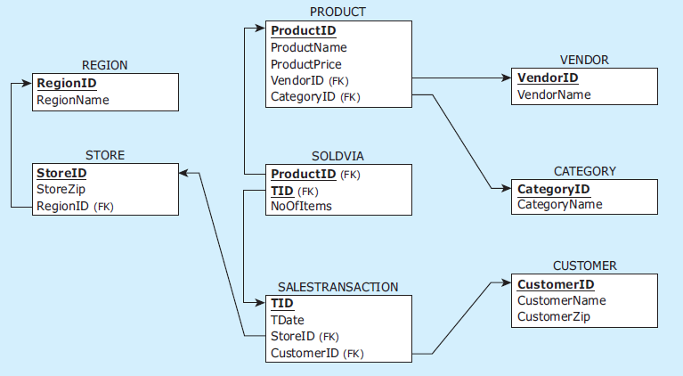
Relational schema: ZAGI Retail Company Sales Department Database
Notes:
This example is discussed on Page 70.

Slide 19
CREATE TABLE statements for ZAGI Retail Company Sales Department Database
CREATE TABLE vendor
( vendorid CHAR(2) NOT NULL,
vendorname VARCHAR(25) NOT NULL,
PRIMARY KEY (vendorid) );
CREATE TABLE category
( categoryid CHAR(2) NOT NULL,
categoryname VARCHAR(25) NOT NULL,
PRIMARY KEY (categoryid) );
CREATE TABLE product
( productid CHAR(3) NOT NULL,
productname VARCHAR(25) NOT NULL,
productprice NUMERIC(7,2) NOT NULL,
vendorid CHAR(2) NOT NULL,
categoryid CHAR(2) NOT NULL,
PRIMARY KEY (productid),
FOREIGN KEY (vendorid) REFERENCES vendor(vendorid),
FOREIGN KEY (categoryid) REFERENCES category(categoryid) );
CREATE TABLE region
( regionid CHAR(1) NOT NULL,
regionname VARCHAR(25) NOT NULL,
PRIMARY KEY (regionid) );
Notes:
This example is discussed on Pages 129-131.

Slide 20
CREATE TABLE statements for ZAGI Retail Company Sales Department Database
CREATE TABLE store
( storeid VARCHAR(3) NOT NULL,
storezip CHAR(5) NOT NULL,
regionid CHAR(1) NOT NULL,
PRIMARY KEY (storeid),
FOREIGN KEY (regionid) REFERENCES region(regionid) );
CREATE TABLE customer
( customerid CHAR(7) NOT NULL,
customername VARCHAR(15) NOT NULL,
customerzip CHAR(5) NOT NULL,
PRIMARY KEY (customerid) );
CREATE TABLE salestransaction
( tid VARCHAR(8) NOT NULL,
customerid CHAR(7) NOT NULL,
storeid VARCHAR(3) NOT NULL,
tdate DATE NOT NULL,
PRIMARY KEY (tid),
FOREIGN KEY (customerid) REFERENCES customer(customerid),
FOREIGN KEY (storeid) REFERENCES store(storeid) );
CREATE TABLE soldvia
( productid CHAR(3) NOT NULL,
tid VARCHAR(8) NOT NULL,
noofitems INT NOT NULL,
PRIMARY KEY (productid, tid),
FOREIGN KEY (productid) REFERENCES product(productid),
FOREIGN KEY (tid) REFERENCES salestransaction(tid) );
Notes:
This example is discussed on Pages 129-131.

Slide 21
DROP TABLE statements for ZAGI Retail Company Sales Department Database
INVALID SEQUENCE
DROP TABLE region;
DROP TABLE store;
DROP TABLE salestransaction;
DROP TABLE product;
DROP TABLE vendor;
DROP TABLE category;
DROP TABLE customer;
DROP TABLE soldvia;
VALID SEQUENCE
DROP TABLE soldvia;
DROP TABLE salestransaction;
DROP TABLE store;
DROP TABLE product;
DROP TABLE vendor;
DROP TABLE region;
DROP TABLE category;
DROP TABLE customer;
Notes:
This example is discussed on Pages 131-132.

Slide 22
INSERT INTO
INSERT INTO
Used to populate the created relations with data
OMAR ONLY - GOTO MYSQL AND SHOW DATABASE COMMANDS

Slide 23
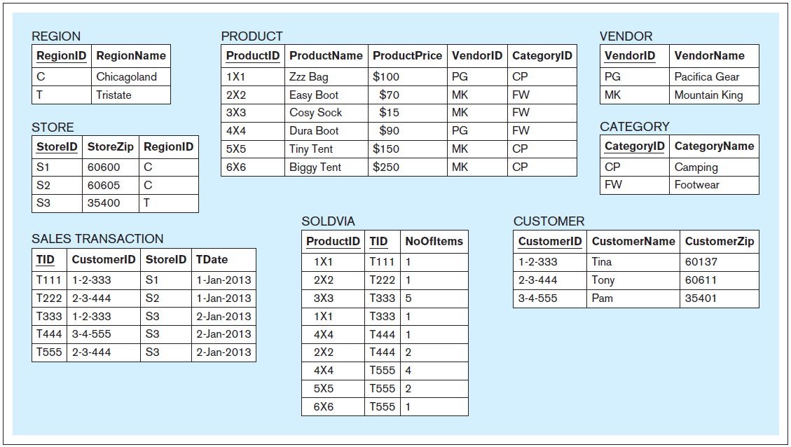
Data records: ZAGI Retail Company Sales Department Database
Notes:
This example is discussed on Page 70.

Slide 24
INSERT INTO statements for ZAGI Retail Company Sales Department Database
INSERT INTO vendor VALUES ('PG','Pacifica Gear');
INSERT INTO vendor VALUES ('MK','Mountain King');
INSERT INTO category VALUES ('CP','Camping');
INSERT INTO category VALUES ('FW','Footwear');
INSERT INTO product VALUES ('1X1','Zzz Bag',100,'PG','CP');
INSERT INTO product VALUES ('2X2','Easy Boot',70,'MK','FW');
INSERT INTO product VALUES ('3X3','Cosy Sock',15,'MK','FW');
INSERT INTO product VALUES ('4X4','Dura Boot',90,'PG','FW');
INSERT INTO product VALUES ('5X5','Tiny Tent',150,'MK','CP');
INSERT INTO product VALUES ('6X6','Biggy Tent',250,'MK','CP');
INSERT INTO region VALUES ('C','Chicagoland');
INSERT INTO region VALUES ('T','Tristate');
INSERT INTO store VALUES ('S1','60600','C');
INSERT INTO store VALUES ('S2','60605','C');
INSERT INTO store VALUES ('S3','35400','T');
INSERT INTO customer VALUES ('1-2-333','Tina','60137');
INSERT INTO customer VALUES ('2-3-444','Tony','60611');
INSERT INTO customer VALUES ('3-4-555','Pam','35401');
Notes:
This example is discussed on Pages 132-134.

Slide 25
INSERT INTO statements for ZAGI Retail Company Sales Department Database
INSERT INTO salestransaction VALUES ('T111','1-2-333','S1','01/Jan/2013');
INSERT INTO salestransaction VALUES ('T222','2-3-444','S2','01/Jan/2013');
INSERT INTO salestransaction VALUES ('T333','1-2-333','S3','02/Jan/2013');
INSERT INTO salestransaction VALUES ('T444','3-4-555','S3','02/Jan/2013');
INSERT INTO salestransaction VALUES ('T555','2-3-444','S3','02/Jan/2013');
INSERT INTO soldvia VALUES ('1X1','T111',1);
INSERT INTO soldvia VALUES ('2X2','T222',1);
INSERT INTO soldvia VALUES ('3X3','T333',5);
INSERT INTO soldvia VALUES ('1X1','T333',1);
INSERT INTO soldvia VALUES ('4X4','T444',1);
INSERT INTO soldvia VALUES ('2X2','T444',2);
INSERT INTO soldvia VALUES ('4X4','T555',4);
INSERT INTO soldvia VALUES ('5X5','T555',2);
INSERT INTO soldvia VALUES ('6X6','T555',1);
Notes:
This example is discussed on Pages 132-134.

Slide 26
DQL
SELECT
Notes:
This example is discussed on Page 153.

Slide 27
SELECT
SELECT
Used for the retrieval of data from the database relations
Most commonly issued SQL statement
Basic form:
SELECT <columns>
FROM <table>
A typical SQL query has the form: select A₁, A₂, ..., A_{n} from r₁, r₂, ..., r_{m} where P
A_{i} represents an attribute
R_{i} represents a relation
P is a predicate.
The result of an SQL query is a relation.

Slide 28
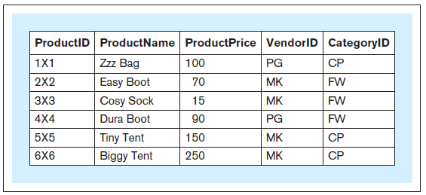
SELECT
Query 1 text: Retrieve the entire contents of the relation PRODUCT
Query 1: SELECT productid, productname, productprice, vendorid, categoryid FROM product;
Query 1 result:
Notes:
This example is discussed on Page 134.

Slide 29
SELECT
Query 1 text: Retrieve the entire contents of the relation PRODUCT
Query 1a: SELECT * FROM product;
Query 1a result:
Notes:
This example is discussed on Page 135.

Slide 30
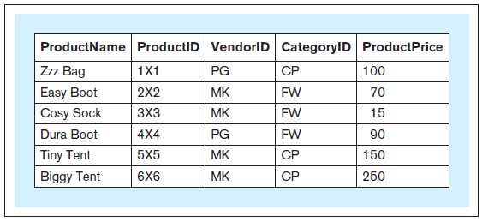
SELECT
Query 2 text: Retrieve the entire contents of the relation PRODUCT and show the columns in the following order: ProductName, ProductID, VendorID, CategoryID, ProductPrice
Query 2: SELECT productname, productid, vendorid, categoryid, productprice FROM product;
Query 2 result:
Notes:
This example is discussed on Page 135.

Slide 31
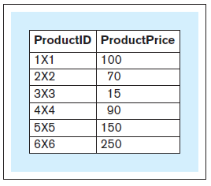
SELECT
Query 3 text: For the relation PRODUCT, show the columns ProductID and ProductPrice
Query 3: SELECT productid, productprice FROM product;
Query 3 result:
Notes:
This example is discussed on Page 135.

Slide 32
SELECT
SELECT
In addition to displaying columns, the SELECT clause can be used to display derived attributes (calculated columns) represented as expressions
SELECT statement can be structured as follows:
SELECT <columns, expressions> FROM <table>

Slide 33
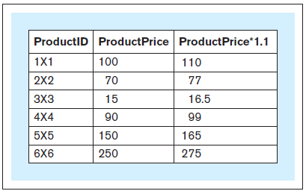
SELECT
Query 3a text: For the relation PRODUCT, show the columns ProductID and ProductPrice and a column showing ProductPrice increased by 10%
Query 3a: SELECT productid, productprice, productprice * 1.1 FROM product;
Query 3a result:
Notes:
This example is discussed on Page 136.

Slide 34
SELECT
SELECT
The SELECT FROM statement can contain other optional keywords, such as WHERE, GROUP BY, HAVING, and ORDER BY, appearing in this order: :
SELECT <columns, expressions>
FROM <tables>
WHERE <row selection condition>
GROUP BY <grouping columns>
HAVING <group selection condition>
ORDER BY <sorting columns, expressions>

Slide 35
WHERE
WHERE
WHERE condition determines which rows should be retrieved and consequently which rows should not be retrieved
The logical condition determining which records to retrieve can use one of the following logical comparison operators:
= Equal to < Less than > Greater than <= Less than or equal to >= Greater than or equal to != Not equal to <> Not equal to (alternative notation)

Slide 36
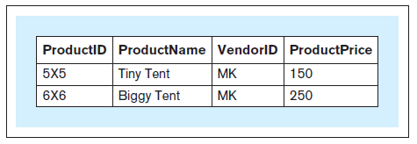
WHERE
Query 4 text: Retrieve the product ID, product name, vendor ID, and product price for each product whose price is above $100
Query 4: SELECT productid, productname, vendorid, productprice FROM product WHERE productprice > 100;
Query 4 result:
Notes:
This example is discussed on Page 136.

Slide 37
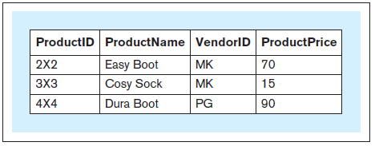
WHERE
Query 5 text: Retrieve the product ID, product name, vendor ID, and product price for each product in the FW category whose price is equal to or below $110
Query 5: SELECT productid, productname, vendorid, productprice FROM product WHERE productprice <= 110 AND categoryid = 'FW';
Query 5 result:
Notes:
This example is discussed on Page 137.

Slide 38
DISTINCT
DISTINCT
Can be used in conjunction with the SELECT statement
Eliminates duplicate values from a query result

Slide 39
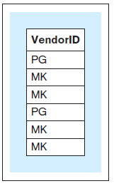
DISTINCT
Query 6 text: Retrieve the VendorID value for each record in the relation PRODUCT
Query 6: SELECT vendorid FROM product;
Query 6 result:
Notes:
This example is discussed on Page 137.

Slide 40
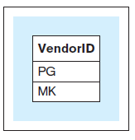
DISTINCT
Query 7 text: Show one instance of all the different VendorID values in the relation PRODUCT Query 7: SELECT DISTINCT vendorid FROM product;
Query 7 result:
Notes:
This example is discussed on Page 137.

Slide 41
ORDER BY
ORDER BY
Used to sort the results of the query by one or more columns (or expressions)

Slide 42
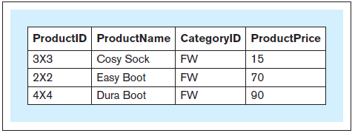
ORDER BY
Query 8 text: Retrieve the product ID, product name, category ID, and product price for each product in the FW product category, sorted by product price Query 8: SELECT productid, productname, categoryid, productprice FROM product WHERE categoryid = 'FW' ORDER BY productprice;
Query 8 result:
Notes:
This example is discussed on Page 138.

Slide 43
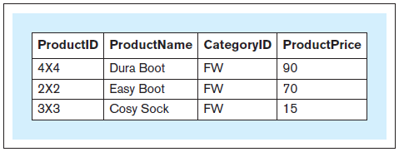
ORDER BY
Query 9 text: Retrieve the product ID, product name, category ID, and product price for each product in the FW product category, sorted by product price in descending order Query 9: SELECT productid, productname, categoryid, productprice FROM product WHERE categoryid = 'FW' ORDER BY productprice DESC;
Query 9 result:
Notes:
This example is discussed on Page 138.

Slide 44
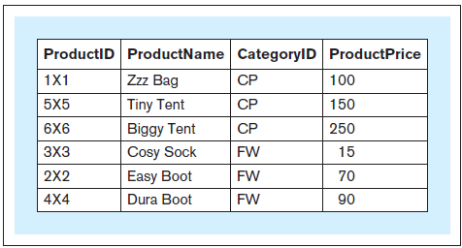
ORDER BY
Query 10 text: Retrieve the product ID, product name, category ID, and product price for each product, sorted by category ID and, within the same category ID, by product price Query 10 : SELECT productid, productname, categoryid, productprice FROM product ORDER BY categoryid, productprice;
Query 10 result:
Notes:
This example is discussed on Page 138.

Slide 45
LIKE
LIKE
Used for retrieval of records whose values partially match a certain criteria

Slide 46
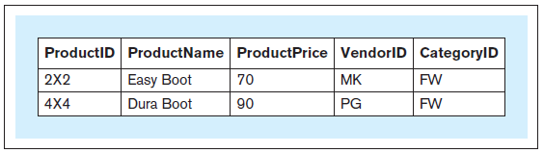
LIKE
Query 11 text: Retrieve the record for each product whose product name contains the phrase ’Boot’
Query 11 : SELECT * FROM product WHERE productname LIKE '%Boot%';
Query 11 result:
Notes:
This example is discussed on Page 139.

Slide 47
AGGREGATE FUNCTIONS

Slide 48
AGGREGATE FUNCTIONS
Aggregate functions
For calculating and summarizing values in queries, SQL provides the following aggregate functions:
COUNT
SUM
AVG
MIN
MAX
Notes:
Functions SUM and AVG operate on numeric values only.

Slide 49
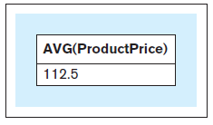
AGGREGATE FUNCTIONS
Query 12 text: Retrieve the average price of all products
Query 12 : SELECT AVG(productprice) FROM product;
Query 12 result:
Notes:
This example is discussed on Page 139.

Slide 50
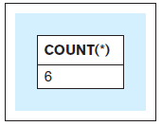
AGGREGATE FUNCTIONS
Query 13 text: Show how many products we offer for sale
Query 13 : SELECT COUNT(*) FROM product;
Query 13 result:
Notes:
This example is discussed on Page 139.

Slide 51
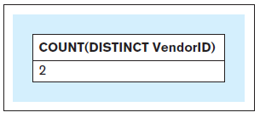
AGGREGATE FUNCTIONS
Query 14 text: Retrieve the number of vendors that supply our products
Query 14 : SELECT COUNT(DISTINCT vendorid) FROM product;
Query 14 result:
Notes:
This example is discussed on Page 140.

Slide 52
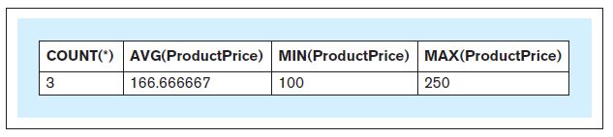
AGGREGATE FUNCTIONS
Query 15 text: Retrieve the number of products, average product price, lowest product price, and highest product price in the CP product category
Query 15 : SELECT COUNT(*), AVG(productprice), MIN(productprice), MAX(productprice) FROM product WHERE categoryid = 'CP';
Query 15 result:
Notes:
This example is discussed on Page 140.

Slide 53
GROUP BY
GROUP BY
Enables summarizations across the groups of related data within tables

Slide 54
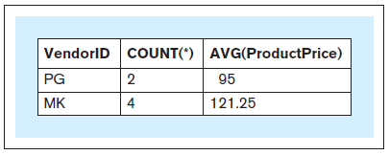
GROUP BY
Query 16 text: For each vendor, retrieve the vendor ID, number of products supplied by the vendor, and average price of the products supplied by the vendor
Query 16 : SELECT vendorid, COUNT(*), AVG(productprice) FROM product GROUP BY vendorid;
Query 16 result:
Notes:
This example is discussed on Pages 140-141.

Slide 55
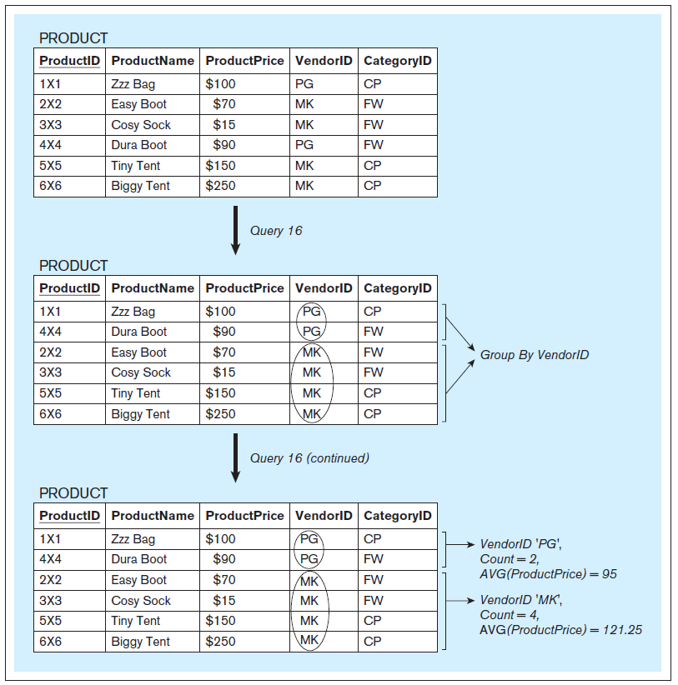
Query 16 illustration
Notes:
This example is discussed on Pages 140-141.

Slide 56
GROUP BY
Query 16 text: For each vendor, retrieve the vendor ID, number of products supplied by the vendor, and average price of the products supplied by the vendor
Query 16 : SELECT vendorid, COUNT(*), AVG(productprice) INVALID FROM product; ERROR MESSAGE RETURNED
Notes:
This example is discussed on Page 142.

Slide 57
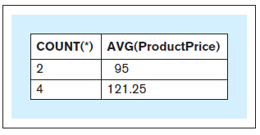
GROUP BY
Query 17 text: For each vendor, retrieve the number of products supplied by the vendor and the average price of the products supplied by the vendor
Query 17 : SELECT COUNT(*), AVG(productprice) FROM product GROUP BY vendorid;
Query 17 result (vs. Query 16):
Query 17 result
Query 16 result
Notes:
This example is discussed on Pages 142.

Slide 58
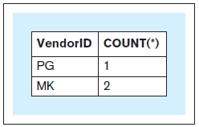
GROUP BY
Query 18 text: For each vendor, retrieve the vendor ID and the number of products with a product price of $100 or higher supplied by the vendor
Query 18 : SELECT vendorid, COUNT(*) FROM product WHERE productprice >= 100 GROUP BY vendorid;
Query 18 result:
Notes:
This example is discussed on Pages 142-143.

Slide 59
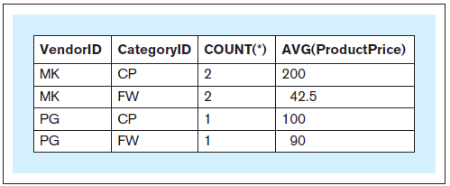
GROUP BY
Query 19 text: Consider the groups of products where each group contains the products that are from the same category supplied by the same vendor. For each such group, retrieve the vendor ID, product category ID, number of products in the group, and average price of the products in the group.
Query 19 : SELECT vendorid, categoryid, COUNT(*), AVG(productprice) FROM product GROUP BY vendorid, categoryid;
Query 19 result:
Notes:
This example is discussed on Page 143.

Slide 60
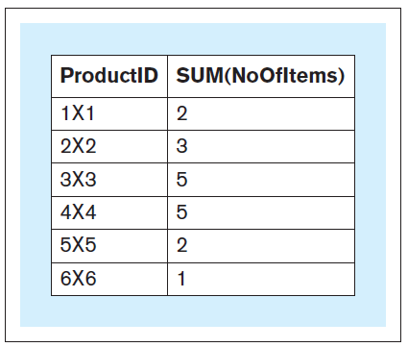
GROUP BY
Query 20 text: For each product, retrieve the ProductID value and the total number of product items sold within all sales transactions.
Query 20 : SELECT productid, SUM(noofitems) FROM soldvia GROUP BY productid;
Query 20 result:
Notes:
This example is discussed on Page 143.

Slide 61
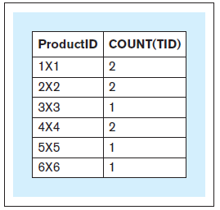
GROUP BY
Query 21 text: For each product, retrieve the ProductID value and the number of sales transactions in which the product was sold
Query 21: SELECT productid, COUNT(*) FROM soldvia GROUP BY productid;
Query 21 result:
Notes:
This example is discussed on Pages 143-144.

Slide 62
HAVING
HAVING
Enables summarizations across the groups of related data within tables
Determines which groups will be displayed in the result of a query and, consequently, which groups will not be displayed in the result of the query
A query that contains a HAVING clause must also contain a GROUP BY clause

Slide 63
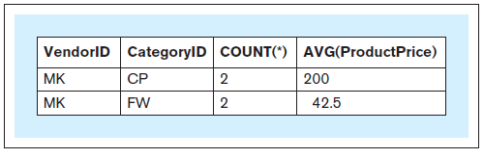
HAVING
Query 22 text: Consider the groups of products where each group contains the products that are from the same category and supplied by the same vendor. For each such group that has more than one product, retrieve the vendor ID, product category ID, number of products in the group, and average price of the products in the group.
Query 22: SELECT vendorid, categoryid, COUNT(*), AVG(productprice) FROM product GROUP BY vendorid, categoryid HAVING COUNT(*) > 1;
Query 22 result:
Notes:
This example is discussed on Page 144.

Slide 64
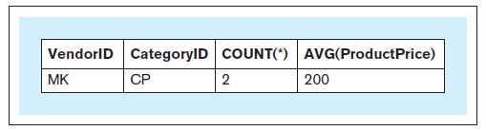
HAVING
Query 23 text: Consider the groups of products where each group contains the products that are from the same category, supplied by the same vendor, and whose product price is $50 or higher. For each such group that has more than one product, retrieve the vendor ID, product category ID, number of products in the group, and average price of the products.
Query 23: SELECT vendorid, categoryid, COUNT(*), AVG(productprice) FROM product WHERE productprice >= 50 GROUP BY vendorid, categoryid HAVING COUNT(*) > 1;
Query 23 result:
Notes:
This example is discussed on Pages 144-145.

Slide 65
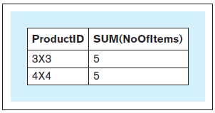
HAVING
Query 24 text: For each product that has more than three items sold within all sales transactions, retrieve the ProductID value and the total number of product items sold within all sales transactions
Query 24: SELECT productid, SUM(noofitems) FROM soldvia GROUP BY productid HAVING SUM(noofitems) > 3;
Query 24 result:
Notes:
This example is discussed on Page 145.

Slide 66
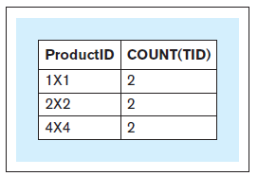
HAVING
Query 25 text: For each product that was sold in more than one sales transaction, retrieve the ProductID value and the number of sales transactions in which the product was sold
Query 25: SELECT productid, COUNT(*) FROM soldvia GROUP BY productid HAVING COUNT(*) > 1;
Query 25 result:
Notes:
This example is discussed on Page 145.

Slide 67
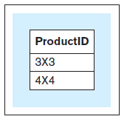
HAVING
Query 26 text: For each product that has more than three items sold within all sales transactions, retrieve the ProductID value
Query 26: SELECT productid FROM soldvia GROUP BY productid HAVING SUM(noofitems) > 3;
Query 26 result:
Notes:
This example is discussed on Page 146.

Slide 68
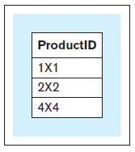
HAVING
Query 27 text: For each product that was sold in more than one sales transaction, retrieve the ProductID value
Query 27: SELECT productid FROM soldvia GROUP BY productid HAVING COUNT(*) > 1;
Query 27 result:
Notes:
This example is discussed on Page 146.

Slide 69
NESTED QUERIES
Nested Query
A query that is used within another query
A nested query is also referred to as an inner query,
The query that uses the nested query is referred to as an outer query
Notes:
A query may contain another query (or queries).

Slide 70
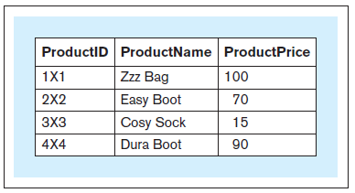
NESTED QUERIES
Query 28 text: For each product whose product price is below the average price of all products, retrieve the product ID, product name, and product price
Query 28: SELECT productid, productname, productprice FROM product WHERE productprice < ( SELECT AVG(productprice) FROM product);
Query 28 result:
Notes:
This example is discussed on Page 146.

Slide 71
NESTED QUERIES
Query 28 text: For each product whose product price is below the average price of all products, retrieve the product ID, product name, and product price
Query 28: SELECT productid, productname, productprice INVALID FROM product WHERE productprice < AVG(productprice);
Notes:
This example is discussed on Page 146-147.

Slide 72
IN
IN
Used for comparison of a value with a set of values

Slide 73
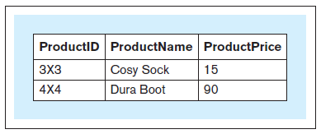
IN
Query 29 text: For each product that has more than three items sold within all sales transactions, retrieve the product ID, product name, and product price
Query 29: SELECT productid, productname, productprice FROM product WHERE productid IN (SELECT productid FROM soldvia GROUP BY productid HAVING SUM(noofitems) > 3);
Query 29 result:
Notes:
This example is discussed on Page 147.

Slide 74
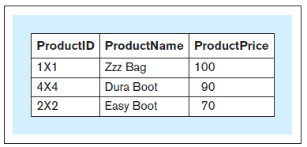
IN
Query 30 text: For each product whose items were sold in more than one sales transaction, retrieve the product id, product name and product price
Query 30 : SELECT productid, productname, productprice FROM product WHERE productid IN (SELECT productid FROM soldvia GROUP BY productid HAVING COUNT(*) > 1);
Query 30 result:
Notes:
This example is discussed on Pages 147-148.

Slide 75
JOIN Quick Intro
JOIN
Facilitates the querying of multiple tables

Slide 76
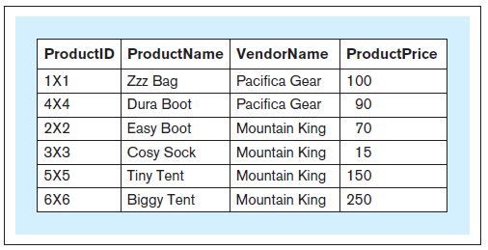
JOIN
Query 31 text: For each product, retrieve the product ID, name of the product, name of the vendor of the product, and price of the product
Query 31: SELECT productid, productname, vendorname, productprice FROM product, vendor WHERE product.vendorid = vendor.vendorid;
Query 31 result:
Notes:
This example is discussed on Pages 148-151.

Slide 77
JOIN
Query 32: SELECT productid, productname, vendorname, productprice FROM product, vendor;
Notes:
This example is discussed on Pages 148-151.

Slide 78
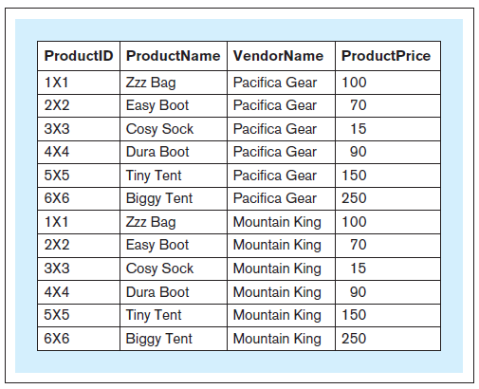
JOIN
Query 32 result:
Notes:
This example is discussed on Pages 148-151.

Slide 79
JOIN
Query 33: SELECT * FROM product, vendor;
Query 34: SELECT * FROM product, vendor WHERE product.vendorid = vendor.vendorid;
Notes:
This example is discussed on Pages 148-151.

Slide 80
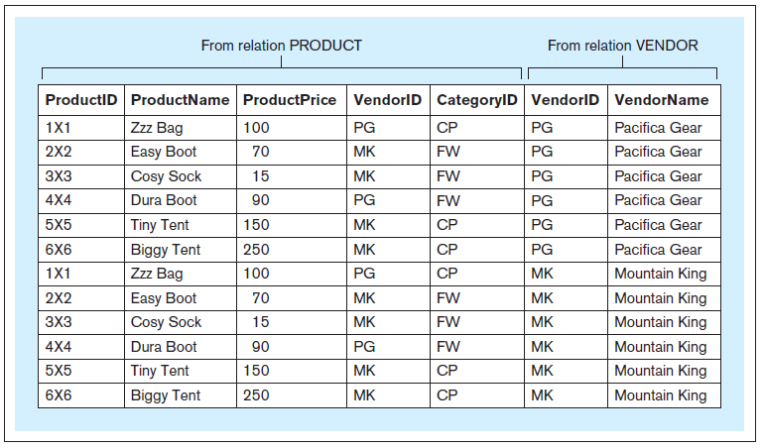
JOIN
Query 33 result:
Notes:
This example is discussed on Pages 148-151.

Slide 81
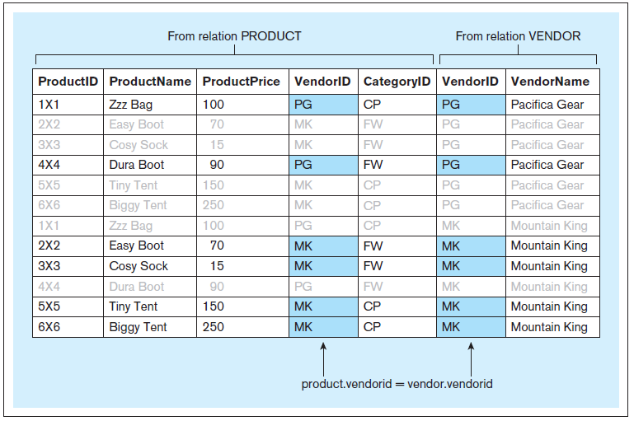
JOIN
Formation of the result of Query 34:
Notes:
This example is discussed on Pages 148-151.

Slide 82
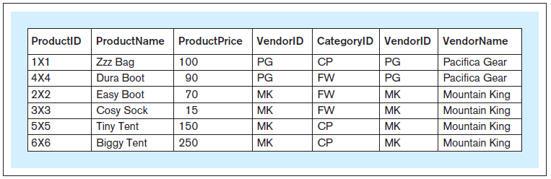
JOIN
Query 34 result:
Notes:
This example is discussed on Pages 148-151.

Slide 83
ALIAS
Alias
An alternative and usually shorter name that can be used anywhere within a query instead of the full relation name
Notes:
Columns can also have aliases but their use is more restricted within a query.

Slide 84
ALIAS
Query 31 text: For each product, retrieve the product ID, name of the product, name of the vendor of the product, and price of the product
Query 31: SELECT productid, productname, vendorname, productprice FROM product, vendor WHERE product.vendorid = vendor.vendorid;
Query 31 result:
Notes:
This example is discussed on Page 151.

Slide 85
ALIAS
Query 31a text: For each product, retrieve the product ID, name of the product, (same query) name of the vendor of the product, and price of the product
Query 31a: SELECT p.productid, p.productname, v.vendorname, p.productprice FROM product p, vendor v WHERE p.vendorid = v.vendorid;
Query 31a result: (same result)
Notes:
This example is discussed on Page 151.

Slide 86
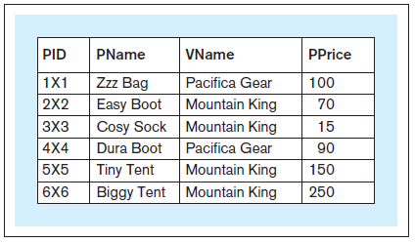
ALIAS
Query 31b text: For each product, retrieve the product id, name of the product, (same query) name of the vendor of the product, and price of the product
Query 31b: SELECT p.productid pid, p.productname pname, v.vendorname vname, p.productprice pprice FROM product p, vendor v WHERE p.vendorid = v.vendorid;
Query 31b result: (same result, different column names in the result)
Notes:
This example is discussed on Page 151.

Slide 87
ALIAS
Query 31c text: For each product, retrieve the product id, name of the product, (same query) name of the vendor of the product, and price of the product
Query 31c: SELECT p.productid AS pid, p.productname AS pname, v.vendorname AS vname, p.productprice AS pprice FROM product p, vendor v WHERE p.vendorid = v.vendorid;
Query 31c result: (same result, as Query 31b)
Notes:
This example is discussed on Page 152.

Slide 88
JOINING MULTIPLE RELATIONS
Joining multiple relations
A query can contain multiple JOIN conditions, joining multiple relations

Slide 89
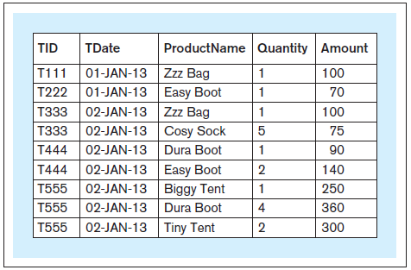
JOINING MULTIPLE RELATIONS
Query 35 text: For each line item of a sales transaction, retrieve the transaction identifier, date of the transaction, name of the product that was sold, quantity sold, and amount charged
Query 35: SELECT t.tid, t.tdate, p.productname, sv.noofitems AS quantity, (sv.noofitems * p.productprice) AS amount FROM product p, salestransaction t, soldvia sv WHERE sv.productid = p.productid AND sv.tid = t.tid ORDER BY t.tid;
Query 35 result:
Notes:
This example is discussed on Page 152.

Slide 90
UPDATE

Slide 91
UPDATE - Used to modify the data stored in database relations
Insert Statement 1: INSERT INTO product VALUES ('7×7','Airy Sock',1000,'MK','CP');
Update Statement 1: UPDATE product SET productprice = 10 WHERE productid = '7×7';
Alter Statement 3: ALTER TABLE product ADD (discount NUMERIC(3,2) );
Update Statement 2: UPDATE product SET discount = 0.2;
Update Statement 3: UPDATE product SET discount = 0.3 WHERE vendorid = 'MK';
Alter Statement 4: ALTER TABLE product DROP (discount);
Notes:
This example is discussed on Pages 153-154.

Slide 92
DELETE
DELETE
Used to delete the data stored in database relations
Delete Statement 1:
DELETE FROM product WHERE productid = '7×7';

Slide 93
DELETE
Notes:
This example is discussed on Page 154.

Slide 94
VIEW
VIEW
Mechanism in SQL that allows the structure of a query to be saved in the RDBMS
Also known as a virtual table
View is not an actual table and does not have any data physically saved
Every time a view is invoked, it executes a query that retrieves the data from the actual tables
A view can be used in SELECT statements just like any other table from a database

Slide 95
VIEW
Create View Statement 1:
CREATE VIEW products_more_than_3_sold AS
SELECT productid, productname, productprice
FROM product
WHERE productid IN
(
SELECT productid
FROM soldvia
GROUP BY productid
HAVING SUM(noofitems) > 3
);
Notes:
This example is discussed on Pages 154-155.

Slide 96
VIEW
Query 29 text: For each product that has more than three items sold within all sales transactions, retrieve the product ID, product name, and product price
Query 29: SELECT productid, productname, productprice FROM product WHERE productid IN (SELECT productid FROM soldvia GROUP BY productid HAVING SUM(noofitems) > 3);
Query 29 result:
Notes:
This example is discussed on Pages 154-155.

Slide 97
VIEW
Query 29a text: For each product that has more than three items sold (same query) within all sales transactions, retrieve the product ID, product name, and product price
Query 29a: SELECT * FROM products_more_than_3_sold;
Query 29a result:
(same result)
Notes:
This example is discussed on Pages 154-155.

Slide 98
VIEW
Create View Statement 2:
CREATE VIEW products_in_multiple_trnsc AS SELECT productid, productname, productprice FROM product WHERE productid IN (SELECT productid FROM soldvia GROUP BY productid HAVING COUNT(*) > 1);
Notes:
This example is discussed on Page 155.

Slide 99
VIEW
Query 30 text: For each product whose items were sold in more than one sales transaction, retrieve the product name and product price
Query 30 : SELECT productid, productname, productprice FROM product WHERE productid IN (SELECT productid FROM soldvia GROUP BY productid HAVING COUNT(*) > 1);
Query 30 result:
Notes:
This example is discussed on Page 155.

Slide 100
VIEW
Query 30a text: For each product whose items were sold in more than one sales transaction, retrieve the product name and product price
Query 30a : SELECT * FROM products_in_multiple_trnsc;
Query 30a result:
(same result)
Notes:
This example is discussed on Page 155.

Slide 101
SET OPERATORS
Set operators
Standard set operators: union, intersection, and difference
Used to combine the results of two or more SELECT statements that are union compatible
Two sets of columns are union compatible if they contain the same number of columns, and if the data types of the columns in one set match the data types of the columns in the other set
The first column in one set has a compatible data type with the data type of the first column in the other set, the second column in one set has a compatible data type with the data type of the second column in the other set, and so on.
The set operators can combine results from SELECT statements querying relations, views, or other SELECT queries.

Slide 102
SET OPERATORS
UNION
Used to combine the union compatible results of two SELECT statements by listing all rows from the result of the first SELECT statement and all rows from the result of the other SELECT statement
If two or more rows are identical only one of them is shown (duplicates are eliminated from the result)

Slide 103
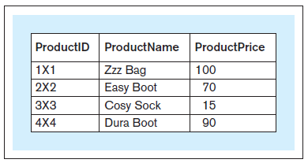
SET OPERATORS
Query 36 text: Retrieve the product ID, product name, and product price for each product that has more than three items sold within all sales transactions or whose items were sold in more than one sales transaction
Query 36: SELECT * FROM products_more_than_3_sold UNION SELECT * FROM products_in_multiple_trnsc;
Query 36 result:
Notes:
This example is discussed on Pages 155-156.

Slide 104
SET OPERATORS
INTERSECT
Used to combine the results of two SELECT statements that are union compatible by listing every row that appears in the result of both of the SELECT statements

Slide 105
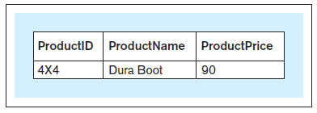
SET OPERATORS
Query 37 text: Retrieve the product ID, product name, and product price for each product that has more than three items sold within all sales transactions and whose items were sold in more than one sales transaction
Query 37: SELECT * FROM products_more_than_3_sold INTERSECT SELECT * FROM products_in_multiple_trnsc;
Query 37 result:
Notes:
This example is discussed on Page 156.

Slide 106
SET OPERATORS
MINUS (EXCEPT)
Used to combine the results of two SELECT statements that are union compatible by listing every row from the result of the first SELECT statement that does not appear in the result of the other SELECT statement

Slide 107
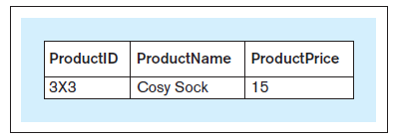
SET OPERATORS
Query 38 text: Retrieve the product ID, product name, and product price for each product that has more than three items sold within all sales transactions but whose items were not sold in more than one sales transaction
Query 38: SELECT * FROM products_more_than_3_sold MINUS SELECT * FROM products_in_multiple_trnsc;
Query 38 result:
Notes:
This example is discussed on Pages 156-157.

Slide 108
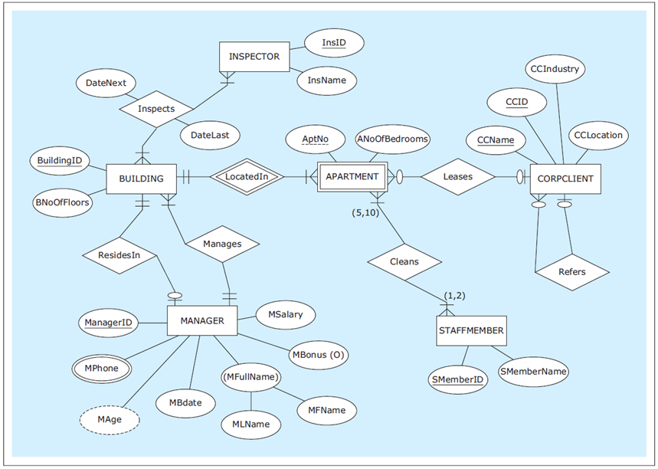
ER diagram: HAFH Realty Company Property Management Database
Notes:
This example is discussed on Pages 157-163.

Slide 109
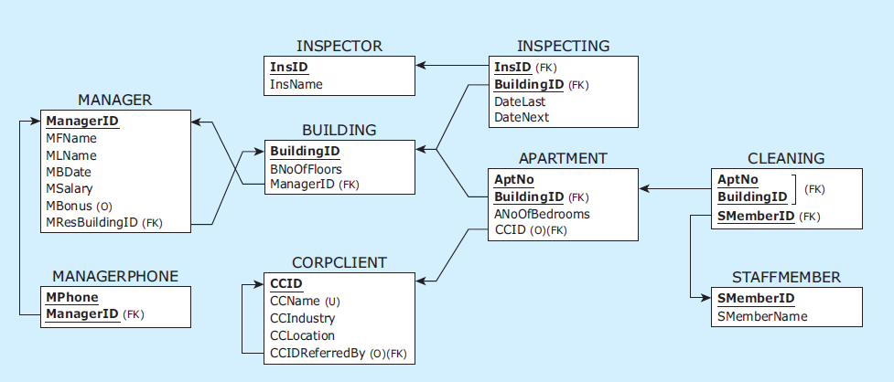
Relational schema: HAFH Realty Company Property Management Database
Notes:
This example is discussed on Pages 157-163.

Slide 110
CREATE TABLE statements for HAFH Realty Company Property Management Database
CREATE TABLE manager
( managerid CHAR(4) NOT NULL,
mfname VARCHAR(15) NOT NULL,
mlname VARCHAR(15) NOT NULL,
mbdate DATE NOT NULL,
msalary NUMERIC(9,2) NOT NULL,
mbonus NUMERIC(9,2),
mresbuildingid CHAR(3),
PRIMARY KEY (managerid) );
CREATE TABLE managerphone
( managerid CHAR(4) NOT NULL,
mphone CHAR(11) NOT NULL,
PRIMARY KEY (managerid, mphone),
FOREIGN KEY (managerid) REFERENCES manager(managerid) );
CREATE TABLE building
( buildingid CHAR(3) NOT NULL,
bnooffloors INT NOT NULL,
bmanagerid CHAR(4) NOT NULL,
PRIMARY KEY (buildingid),
FOREIGN KEY (bmanagerid) REFERENCES manager(managerid) );
Notes:
This example is discussed on Pages 157-163.

Slide 111
CREATE TABLE statements for HAFH Realty Company Property Management Database
CREATE TABLE inspector
( insid CHAR(3) NOT NULL,
insname VARCHAR(15) NOT NULL,
PRIMARY KEY (insid) );
CREATE TABLE inspecting
( insid CHAR(3) NOT NULL,
buildingid CHAR(3) NOT NULL,
datelast DATE NOT NULL,
datenext DATE NOT NULL,
PRIMARY KEY (insid, buildingid),
FOREIGN KEY (insid) REFERENCES inspector(insid),
FOREIGN KEY (buildingid) REFERENCES building(buildingid) );
CREATE TABLE corpclient
( ccid CHAR(4) NOT NULL,
ccname VARCHAR(25) NOT NULL,
ccindustry VARCHAR(25) NOT NULL,
cclocation VARCHAR(25) NOT NULL,
ccidreferredby CHAR(4),
PRIMARY KEY (ccid),
UNIQUE (ccname),
FOREIGN KEY (ccidreferredby) REFERENCES corpclient(ccid) );
Notes:
This example is discussed on Pages 157-163.

Slide 112
CREATE TABLE statements for HAFH Realty Company Property Management Database
CREATE TABLE apartment
( buildingid CHAR(3) NOT NULL,
aptno CHAR(5) NOT NULL,
anoofbedrooms INT NOT NULL,
ccid CHAR(4),
PRIMARY KEY (buildingid, aptno),
FOREIGN KEY (buildingid) REFERENCES building(buildingid),
FOREIGN KEY (ccid) REFERENCES corpclient(ccid) );
CREATE TABLE staffmember
( smemberid CHAR(4) NOT NULL,
smembername VARCHAR(15) NOT NULL,
PRIMARY KEY (smemberid) );
CREATE TABLE cleaning
( buildingid CHAR(3) NOT NULL,
aptno CHAR(5) NOT NULL,
smemberid CHAR(4) NOT NULL,
CONSTRAINT cleaningpk PRIMARY KEY (buildingid, aptno, smemberid),
CONSTRAINT cleaningfk1 FOREIGN KEY (buildingid, aptno)
REFERENCES apartment(buildingid, aptno),
CONSTRAINT cleaningfk2 FOREIGN KEY (smemberid)
REFERENCES staffmember(smemberid) );
Notes:
This example is discussed on Pages 157-163.

Slide 113
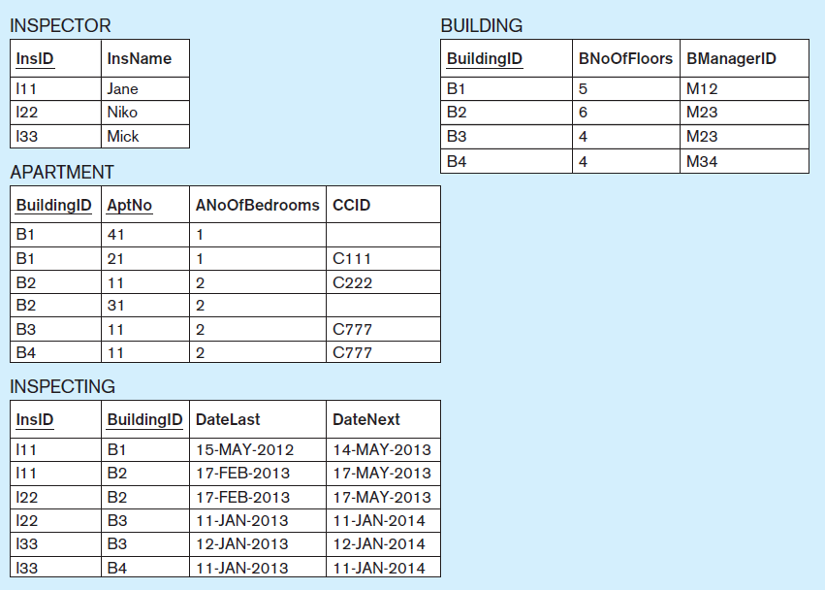
Data records: HAFH Realty Company Property Management Database (part 1)
Notes:
This example is discussed on Pages 157-163.

Slide 114
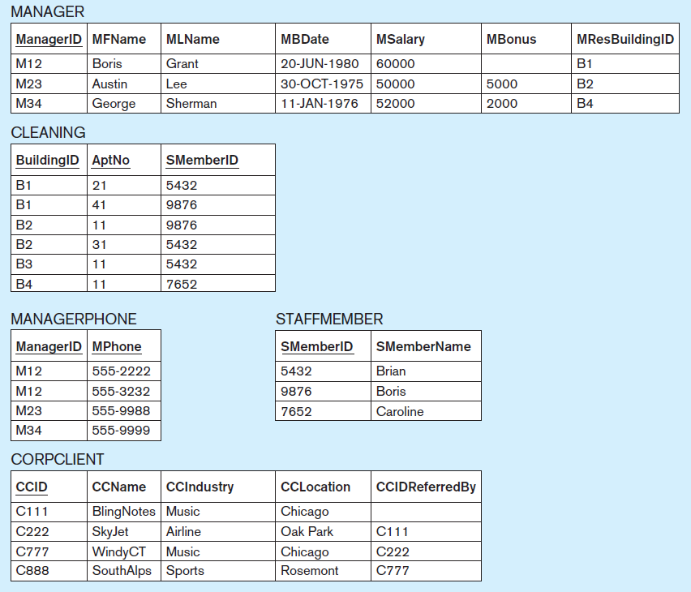
Data records: HAFH Realty Company Property Management Database (part 2)
Notes:
This example is discussed on Pages 157-163.

Slide 115
INSERT INTO statements for HAFH Realty Company Property Management Database
INSERT INTO manager VALUES ('M12', 'Boris', 'Grant', '20/Jun/1980', 60000, null, null);
INSERT INTO manager VALUES ('M23', 'Austin', 'Lee', '30/Oct/1975', 50000, 5000, null);
INSERT INTO manager VALUES ('M34', 'George', 'Sherman', '11/Jan/1976', 52000, 2000, null);
INSERT INTO managerphone VALUES ('M12','555-2222');
INSERT INTO managerphone VALUES ('M12','555-3232');
INSERT INTO managerphone VALUES ('M23','555-9988');
INSERT INTO managerphone VALUES ('M34','555-9999');
INSERT INTO building VALUES ('B1', '5', 'M12');
INSERT INTO building VALUES ('B2', '6', 'M23');
INSERT INTO building VALUES ('B3', '4', 'M23');
INSERT INTO building VALUES ('B4', '4', 'M34');
INSERT INTO inspector VALUES ('I11', 'Jane');
INSERT INTO inspector VALUES ('I22', 'Niko');
INSERT INTO inspector VALUES ('I33', 'Mick');
INSERT INTO inspecting VALUES ('I11','B1','15/May/2012','14/May/2013');
INSERT INTO inspecting VALUES ('I11','B2','17/Feb/2013','17/May/2013');
INSERT INTO inspecting VALUES ('I22','B2','17/Feb/2013','17/May/2013');
INSERT INTO inspecting VALUES ('I22','B3','11/Jan/2013','11/Jan/2014');
INSERT INTO inspecting VALUES ('I33','B3','12/Jan/2013','12/Jan/2014');
INSERT INTO inspecting VALUES ('I33','B4','11/Jan/2013','11/Jan/2014');
INSERT INTO corpclient VALUES ('C111', 'BlingNotes', 'Music', 'Chicago', null);
INSERT INTO corpclient VALUES ('C222', 'SkyJet', 'Airline', 'Oak Park', 'C111');
INSERT INTO corpclient VALUES ('C777', 'WindyCT', 'Music', 'Chicago', 'C222');
INSERT INTO corpclient VALUES ('C888', 'SouthAlps', 'Sports', 'Rosemont', 'C777');
Notes:
This example is discussed on Pages 157-163.

Slide 116
INSERT INTO statements for HAFH Realty Company Property Management Database
INSERT INTO apartment VALUES ('B1', '21', 1, 'C111');
INSERT INTO apartment VALUES ('B1', '41', 1, null);
INSERT INTO apartment VALUES ('B2', '11', 2, 'C222');
INSERT INTO apartment VALUES ('B2', '31', 2, null);
INSERT INTO apartment VALUES ('B3', '11', 2, 'C777');
INSERT INTO apartment VALUES ('B4', '11', 2, 'C777');
INSERT INTO staffmember VALUES ('5432', 'Brian');
INSERT INTO staffmember VALUES ('9876', 'Boris');
INSERT INTO staffmember VALUES ('7652', 'Caroline');
INSERT INTO cleaning VALUES ('B1', '21', '5432');
INSERT INTO cleaning VALUES ('B1', '41', '9876');
INSERT INTO cleaning VALUES ('B2', '11', '9876');
INSERT INTO cleaning VALUES ('B2', '31', '5432');
INSERT INTO cleaning VALUES ('B3', '11', '5432');
INSERT INTO cleaning VALUES ('B4', '11', '7652');
Notes:
This example is discussed on Pages 157-163.

Slide 117
CONSTRAINT MANAGEMENT
Alter Statement 5: ALTER TABLE manager ADD CONSTRAINT fkresidesin FOREIGN KEY (mresbuildingid) REFERENCES building (buildingid);
Update Statement 4: UPDATE manager SET mresbuildingid = 'B1' WHERE managerid = 'M12'; Update Statement 5: UPDATE manager SET mresbuildingid = 'B2' WHERE managerid = 'M23'; Update Statement 6: UPDATE manager SET mresbuildingid = 'B4' WHERE managerid = 'M34';
Alter Statement 6: ALTER TABLE manager MODIFY (mresbuildingid NOT NULL);
Notes:
This example is discussed on Pages 157-163.

Slide 118
CONSTRAINT MANAGEMENT
DROP TABLE sequence HAFH database—First seven tables: DROP TABLE cleaning; DROP TABLE staffmember; DROP TABLE apartment; DROP TABLE corpclient; DROP TABLE inspecting; DROP TABLE inspector; DROP TABLE managerphone;
Alter Statement 7: ALTER TABLE manager DROP CONSTRAINT fkresidesin;
DROP TABLE sequence HAFH database—Last two tables: DROP TABLE building; DROP TABLE manager;
Notes:
This example is discussed on Pages 157-163.

Slide 119
SELF-JOIN
Self-JOIN
A join statement that includes a relation that contains a foreign key referring to itself, and joins a relation with itself in a query

Slide 120

SELF-JOIN
Query 39 text: For all corporate clients that were referred by other corporate clients, retrieve the name of the corporate client and the name of the corporate client that referred it
Query 39: SELECT c.ccname AS client, r.ccname AS recommender FROM corpclient c, corpclient r WHERE r.ccid = c.ccidreferredby;
Query 39 result:
Notes:
This example is discussed on Pages 163-164.

Slide 121
OUTER JOIN
OUTER JOIN
Variation of the JOIN operation that supplements the results with the records from one relation that have no match in the other relation
LEFT OUTER JOIN
RIGHT OUTER JOIN
FULL OUTER JOIN
Notes:
Regular JOIN is also sometimes referred to as an INNER JOIN, to differentiate it from the OUTER JOIN.

Slide 122

INNER JOIN
Query 40: SELECT a.buildingid, a.aptno, c.ccname FROM apartment a, corpclient c WHERE a.ccid = c.ccid;
Query 40 result:
Notes:
This example is discussed on Pages 164-166.

Slide 123

OUTER JOIN
Query 41: SELECT a.buildingid, a.aptno, c.ccname FROM apartment a LEFT OUTER JOIN corpclient c ON a.ccid = c.ccid;
Query 41 result:
Notes:
This example is discussed on Pages 164-166.

Slide 124

OUTER JOIN
Query 42: SELECT a.buildingid, a.aptno, c.ccname FROM apartment a RIGHT OUTER JOIN corpclient c ON a.ccid = c.ccid;
Query 42 result:
Notes:
This example is discussed on Pages 164-166.

Slide 125

OUTER Join
Query 43: SELECT a.buildingid, a.aptno, c.ccname FROM apartment a FULL OUTER JOIN corpclient c ON a.ccid = c.ccid;
Query 43 result:
Notes:
This example is discussed on Pages 164-166.

Slide 126
JOIN WITHOUT USING A PRIMARY KEY/ FOREIGN KEY COMBINATION
Join without using a primary key/foreign key combination
It is possible to join two tables without joining a foreign key column in one table with a primary key column in another table.
A JOIN condition can connect a column from one table with a column from the other table as long as those columns contain the same values.

Slide 127

JOIN WITHOUT USING A PRIMARY KEY/FOREIGN KEY COMBINATION
Query 44 text: For each manager who has a staff member with the same name as the manager’s first name, show the manager’s ID, first name, and last name and the ID of the staff members who have the same name as the manager’s first name
Query 44: SELECT m.managerid, m.mfname, m.mlname, s.smemberid FROM manager m, staffmember s WHERE m.mfname = s.smembername;
Query 44 result:
Notes:
This example is discussed on Page 166.

Slide 128
IS NULL
IS NULL
Used in queries that contain comparisons with an empty value in a column of a record

Slide 129

IS NULL
Query 45 text: Retrieve records for all managers who do not have a bonus
Query 45: SELECT * FROM manager WHERE mbonus IS NULL;
Query 45 result:
Notes:
This example is discussed on Page 166.

Slide 130
EXISTS
EXISTS
In queries where the inner query (nested query) uses columns from the relations listed in the SELECT part of the outer query, the inner query is referred to as a correlated subquery
In such cases, the EXISTS operator can be used to check if the result of the inner correlated query is empty

Slide 131

EXISTS
Query 46 text: Retrieve records for all buildings that have managers living in them
Query 46: SELECT * FROM building b WHERE EXISTS (SELECT * FROM manager m WHERE b.buildingid = m.mresbuildingid);
Query 46 result:
Notes:
This example is discussed on Page 167.

Slide 132
NOT
NOT
Can be used in conjunction with the condition comparison statements returning the Boolean values TRUE or FALSE

Slide 133

NOT
Query 47 text: Retrieve records for all buildings that do not have managers living in them
Query 47: SELECT * FROM building b WHERE NOT EXISTS (SELECT * FROM manager m WHERE b.buildingid = m.mresbuildingid);
Query 47 result:
Notes:
This example is discussed on Page 167.

Slide 134
INSERTING FROM A QUERY
Inserting from a query
A query retrieving the data from one relation can be used to populate another relation

Slide 135
INSERTING FROM A QUERY
Create Table Statement 1: CREATE TABLE cleaningdenormalized ( buildingid CHAR(3) NOT NULL, aptno CHAR(5) NOT NULL, smemberid CHAR(4) NOT NULL, smembername VARCHAR(15) NOT NULL, PRIMARY KEY (buildingid, aptno, smemberid));
Insert Statement 2:
INSERT INTO cleaningdenormalized SELECT c.buildingid, c.aptno, s.smemberid, s.smembername FROM cleaning c, staffmember s WHERE c.smemberid = s.smemberid;
Notes:
This example is discussed on Page 168.

Slide 136
INAPPROPRIATE USE OF OBSERVED VALUES IN SQL
Inappropriate use of Observed Values in SQL
A common beginner’s SQL mistake occurs when novice user creates a simplistic query that produces the correct result by inappropriately using observed values

Slide 137

INAPPROPRIATE USE OF OBSERVED VALUES IN SQL
Request A For each product that has more than three items sold within all sales transactions, retrieve the product id, product name, and product price
SQL Query A: SELECT productid, productname, productprice FROM product WHERE productid IN (SELECT productid FROM soldvia GROUP BY productid HAVING SUM(noofitems) > 3);
SQL Query B: SELECT productid, productname, productprice FROM product WHERE productid IN ('3X3','4X4');
Query A and B Result:
Notes:
This example is discussed on Pages 168-169.

Slide 138
SQL STANDARD AND SQL SYNTAX DIFFERENCES
SQL Standard
SQL became the standard language for querying data contained in a relational database
Notes:
SQL standard is discussed on Page 169.

Slide 139
SQL STANDARD AND SQL SYNTAX DIFFERENCES
SQL standard and SQL syntax differences
Minor SQL syntax differences exist in SQL implementations in various popular RDBMS packages, such as differences in:
DATE and TIME data types
FOREIGN KEY syntax
Usage of AS keyword with aliases
ALTER TABLE syntax
Set operators
FULL OUTER JOIN implementation
Constraint management
GROUP BY restrictions
Notes:
SQL syntax differences are discussed on Paged 170-174. The differences are minor, and a user of SQL in one RDBMS is be able to switch to another RDBMS with very little additional learning effort.

